Slide 1
SMART AGRICULTURE

Slide 2
INTRODUCTION
This is smart farming using IoT in this project we will use the server to store the sensor data.In this project, we are going to use more than 6 sensors.
although, this will be going to be very tough Cause we are going to use 7 sensors with the esp8266.
This is the advanced idea for iot farming. this could be used in agriculture as well. All the data is available on the server so you can monitor it from anywhere.

Slide 3
WHAT IS SMART FARMING USING IOT?
Smart farming project is in trend nowadays. everyone wants their farm and land to be smart because it is attractive and techy and also it reduces the manpower they needed to make the system work.
so, if we want to make such a system follow the given instructions. the IoT farming project sends all the data to the server. now see the working of the project.
there is some sensor that have to be put in the soil.

Slide 4
note the time when you have started and then monitor the changes with the time.
when you change the soil conditioning then the changes you can see at the server.
So, this is iot based on smart farming ,we can deploy it into our garden or far

Slide 5
HOW WE CAN MAKE THIS SMART FARMING USING IOT?
Here, we need a circuit diagram, code.we are going to follow the steps given below and make our circuit.
Here we are going to use two nodemcu.
because we have here 5 analog sensors and 1 DHT.
so we will use 4 soil moisture sensors with the Nodemcu 1 and dht11 and 1 soil moisture sensor with the second node MCU.

Slide 6
and there we need two codes for these two nodemcu.
So, make this project carefully. upload first code with the first nodemcu as we have given below.

Slide 7
COMPONENTS REQUIRED
NodeMcu-2
General-purpose PCB
4 channel ADC multiplexer
5 soil moisture sensor
DHT11
Breadboard
Jumper wires
connecting cables

Slide 8
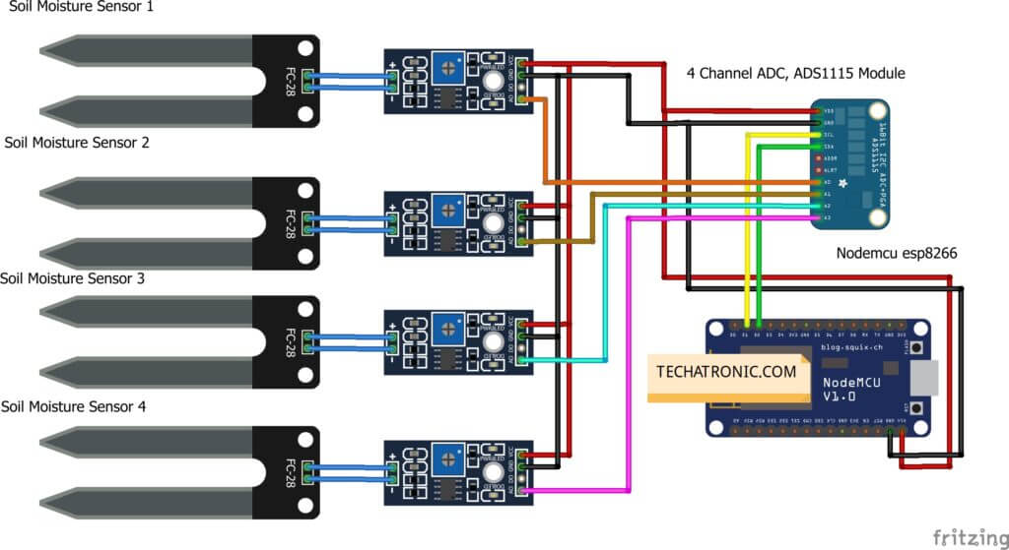
CIRCUIT DIAGRAM
mart farming using IoT Circuit Diagram (1st nodemcu)

Slide 9
Connection Diagram
Nodemcu esp8266 | 4 Channel ADC
VV, Vin | VCC
G, GND | GND
D1 Pin | SCL Pin
D2 Pin | SDA Pin
Soil 1 Sensor | Soil 2 Sensor | Soil 3 Sensor | Soil 4 Sensor | 4 Channel ADC
VCC | VCC | VCC | VCC | VCC
GND | GND | GND | GND | GND
A0 |  |  |  | A0
 | A0 |  |  | A1
 |  | A0 |  | A2
 |  |  | A0 | A3

Slide 10
After making all the connections You need to upload the Code.
Connect all the Soil moisture sensor Vcc to the Nodemcu Vin
Connect Multiplexer Vcc to the Nodemcu Vin
Connect all the Soil moisture sensor Gnd to the Nodemcuo Gnd
Connect Multiplexer Gnd to the Nodemcu Gnd
Soil moisture sensor Output connects to the Multiplexer as given in the above image
After complete, the connection Upload the given code to the Nodemcu. The code is for the First nodemcu.

Slide 11
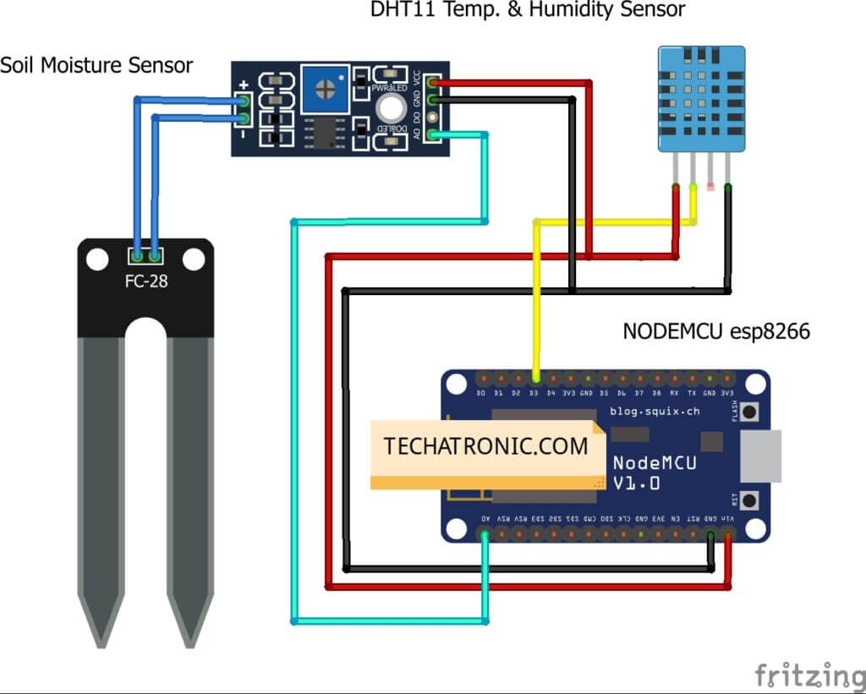
For the Second NodeMCU

Slide 12
Connection Table 2
.
Nodemcu esp8266 | Dht11 Sensor
VV, Vin | ( V ) VCC
G, GND | ( G ) GND
D3 Pin | ( S ) OUT Pin
Nodemcu esp8266 | Soil Moisture Sensor
VV, Vin | VCC
G, GND | GND
A0 Pin | ( A0 ) OUT Pin

Slide 13
Connect DHT 11 output pin to the Nodemcu d3
Soil moisture sensor output to be connected to the A0
Connect DHT 11 VCC to the Nodemcu Vin
Connect DHT 11 Gnd to the Nodemcu Gnd
After complete, the connection Upload the given code to the Nodemcu. This code is for the second nodemcu.

